Slide 1
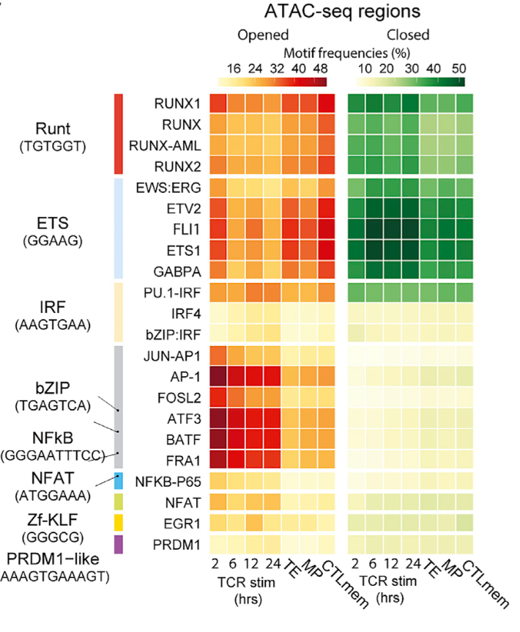
1. Opened or Closed?
Naïve vs. each group
Opened
Closed
WT_TFH
PRDM1KO_TFH
WT_TH1
BCL6KO_TH1
DKO_TH1
DKO_TFH
WT_TFH
PRDM1KO_TFH
WT_TH1
BCL6KO_TH1
DKO_TH1
DKO_TFH
Three approaches to try:
Fig 1C TF list + some curated TFs (E proteins etc.)
The whole TF list from motif data set (Homer+CisBP+JASPAR?)
Apply this for only restricted target genes set (Group IV genes)
Dapeng et al. Immunity 2018
Fig.1C
(C) The heatmap plots the frequencies of the most enriched TF motifs in differentially accessible regions. Plotted motifs have an on-target frequency > 15%, an on-target frequency/background frequency ratio R 1.5, and p % 0.05. For all enriched motifs, see Table S1.

Slide 2
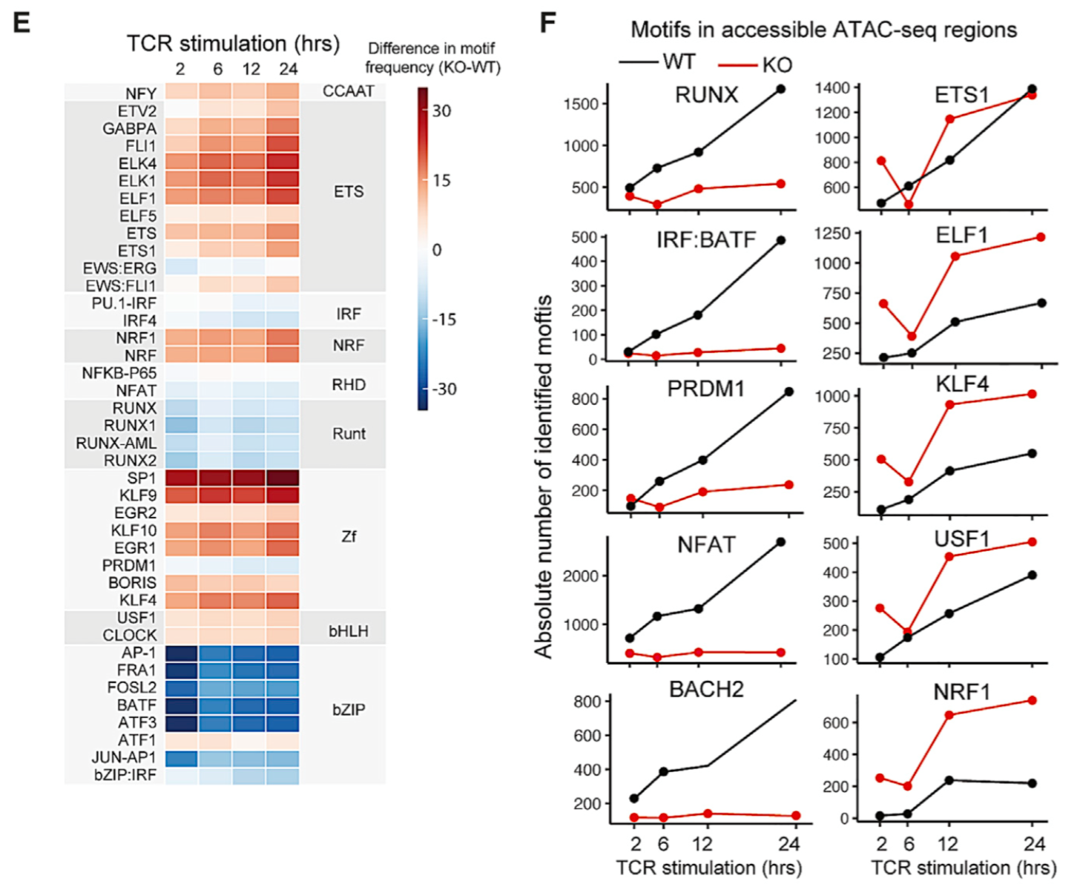
2. Differential motif frequency between KO-WT
Heat map
Bar graph
WT Tfh vs.
WT Th1
DKO Th1 vs.
WT Th1
DKO Th1 vs.
Bcl6KO Th1
DKO Tfh vs.
WT Tfh
DKO Tfh vs.
Prdm1KO Tfh
DKO Tfh
Prdm1KO Tfh
Dapeng et al. Immunity 2018
Fig. 4E & F
(E) The changes in TF-motif frequencies in accessible regions of KO and WT cells identified in (A) during TCR stimulation are expressed as differences in the heatmap (see Table S2 and STAR Methods for ranking motifs). Plotted TF motifs are selected as in Figure 1C.
(F) Charts summarize absolute numbers of TF motifs in accessible regions of WT and KO cells as identified in (A) after TCR stimulation.

Slide 3
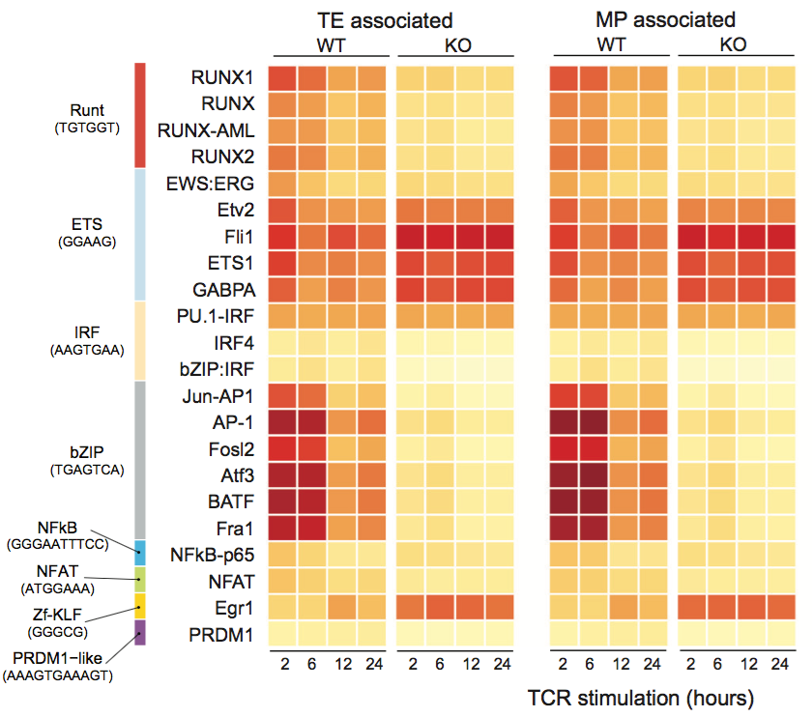

3. Motif Enrichment on Tfh and Th1 associated genes or Group IV or Group II genes?
TFs
TFs
Tfh⁺ genes
Th1⁺ genes
Two approaches to try:
Use Tfh and Th1 associated gene set
Use Group IV and II gene set
TFH Associated
TH1 Associated
TFH Associated
TH1 Associated
WT_TFH
WT_TH1
WT_TFH
WT_TH1
PRDM1KO _TFH
DKO_TFH
PRDM1KO _TFH
DKO_TFH
TFs w/ motif
enrichment
Dapeng et al. Immunity 2018
Fig.S4E
(E) Motif enrichment was calculated within the cis-acting regions that were accessible in specific CTL subsets (indicated at top). Heatmaps depict the percentages of the most highly enriched TF motifs within regions that become accessible upon TCR stimulation (frequency in target sequences >15%, on-target frequency/background-frequency ratio ≥1.5, and pval ≤0.05; see methods and Table S2).

